Slide 1
Game design document
Rajat Jaiswal(2017CS50415)
Rajbir Malik(2017CS10416)

Slide 2
Idea of the game
Our game focuses on decision-making stance of life. We are trying to show how the decisions that people make in their life makes life easy or difficult for them.
The game shows various real-life scenarios of life where one’s decisions can affect one’s life to a varied level.
People can live their life in various ways so we are trying to show them what would have had happened if they would have chosen another path at that instant in life.
The game is multi-leveled, with multiple stories and multiple endings. Thus one can try out all possible combinations, making game playable even after completing the main story!

Slide 3
Core mechanics of the game
This game mainly targets students in their teenage. We have tried to show how the decisions that they make in their school or college affect their future.
Since it a Role-Playing Game(RPG), therefore it is single-player.
The game has different scenarios where you have to make decisions. These decisions will affect various emotional parameters of life like stress, happiness, etc. and will change your score, and also affect the difficulty of upcoming levels.

Slide 4
Technologies used
HTML5
CSS
JavaScript - We are using Impact.js as JavaScript framework.
Adobe Photoshop – For creating Character Sprites and Sprite sheets
Imapct.js (dependencies).
We also made use (though minimal) of technologies listed below to make our game work on PC.
PHP
Apache Server

Slide 5
Implementation Details
We are deploying our idea as an Arcade game.
Everything is built from the scratch with minimal help from the existing frameworks.

Slide 6

Why ARCADE Game ?
Probably because we are still stuck in that 8-bit retro world and always look back to the games we played as a child to find inspiration.
We believe Design Practices is more about code organization, modularity, and reusability. How well can other people read your code and understand it? And this would be better employed when we code everything from the scratch.
Therefore, we decided not to use any fancy game-building engine with pre-coded assets helping to build dazzling and glamourous UI. Instead, we focused on coding everything on our own with minimal help from a basic JavaScript frame. In fact, Impact.js allows you to compile your Web game into a native iOS app. This gives us to test our game on multiple platforms.

Slide 7
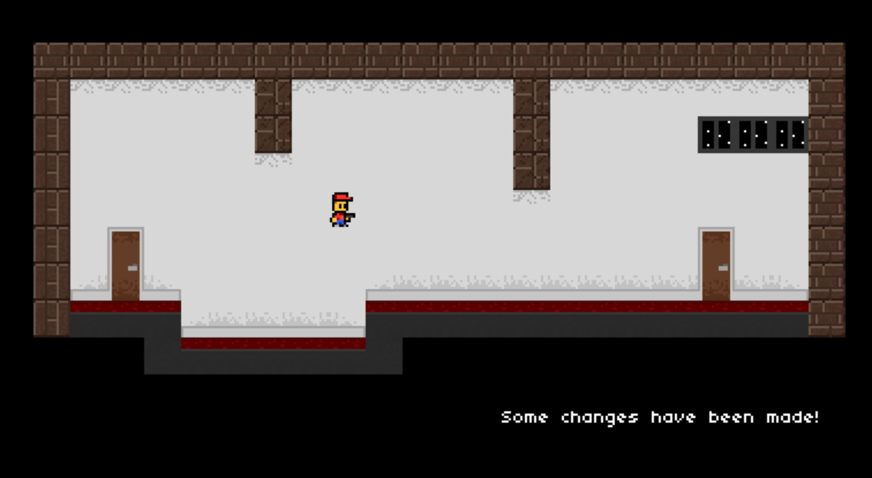
Screencast of Current Basic Implementation

Slide 8
Grading criteria
The most important argument with respect to our game design is the fact that its scope is vast. We can, anytime, add many more levels to simulate a behavior closer to reality.
We have made good use of the time that was provided to us. We have come with a decent implementation with multiple scenario (in accordance with user’s actions) and multiple exits.
Considering all of this, main features of our game include
Complex game logic
FSM’s involved take inputs from game settings, user’s input and playing stats
User based scoring mechanism
Merging both game stats and users choice to give an ultimate score. User actions will lead to change in difficulty of game.
Great responsiveness and memory optimization (owing to the choice of libraries)
Wonders of 8-bit UI universe! (old is gold)
Great story!

Slide 9
GitHub repo link
https://github.com/jaymalk/Task-3
P.S. We couldn’t add you on the repo because we didn’t have your GitHub usernames

